Slide 1
SWEN90016 Software Processes & Project Management
Individuals
Teams and Communication
2019 – Semester 2
Tutorial 4
Copyright University of Melbourne 2017

Slide 2

Today’s aim
Explore teams and the understand the different roles that individuals play in those teams. Communication (including conflict management).

Slide 3
Team Roles
1. Consider the individuals in the team (10 mins)
Consider your own strengths and weaknesses
What roles might you play in your project team?
Initiator: offers ideas, solutions, brainstorm, lateral thinker Information seeker: wants facts Information giver: describes own experience, offers facts, clarification Coordinator: combine contribution of others Evaluator: assess quality of contributions Encourager: praising, accepting, cohesion and warmth Harmonizer: build consensus, humor to neutralize anger Standard setter: focus on goals, standards Follower: agreeable Group observer: provides feedback

Slide 4
Team Roles
What roles are necessary for a high functioning team?
Task
Maintenance
Destructive
Initiator:
Information seeker:
Information giver:
Coordinator:
Evaluator:
Encourager:
Harmonizer:
Standard setter:
Follower:
Group observer:
Blocker
Recognition seeker
Dominator: Free rider:
Avoider:
Lone wolf:
Reasonable combination

Slide 5
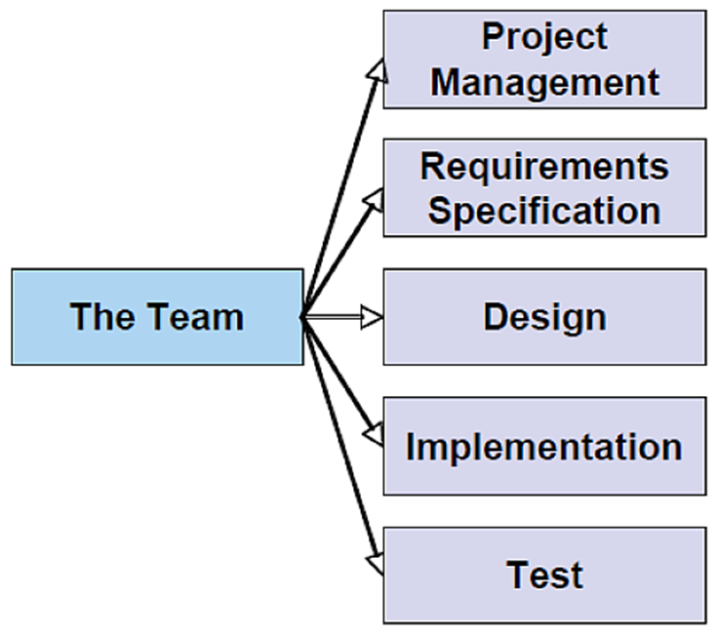
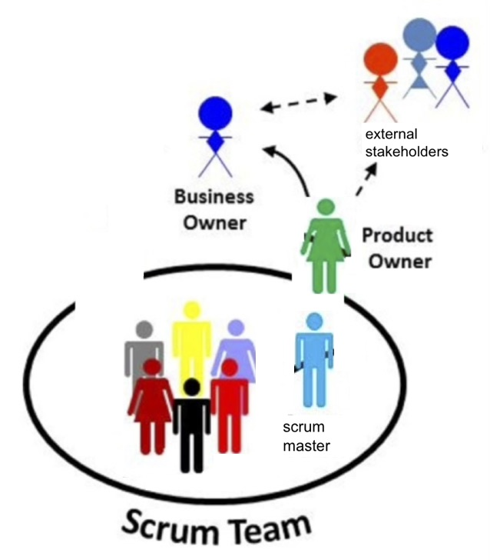
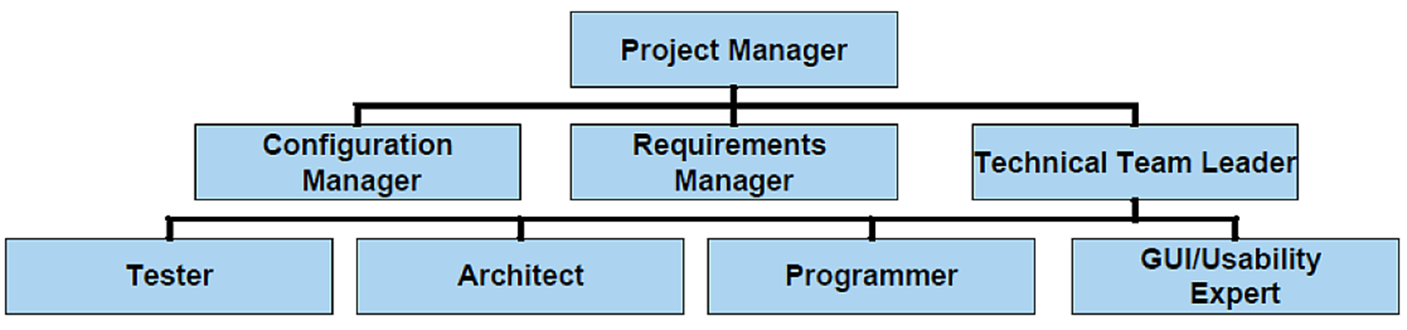
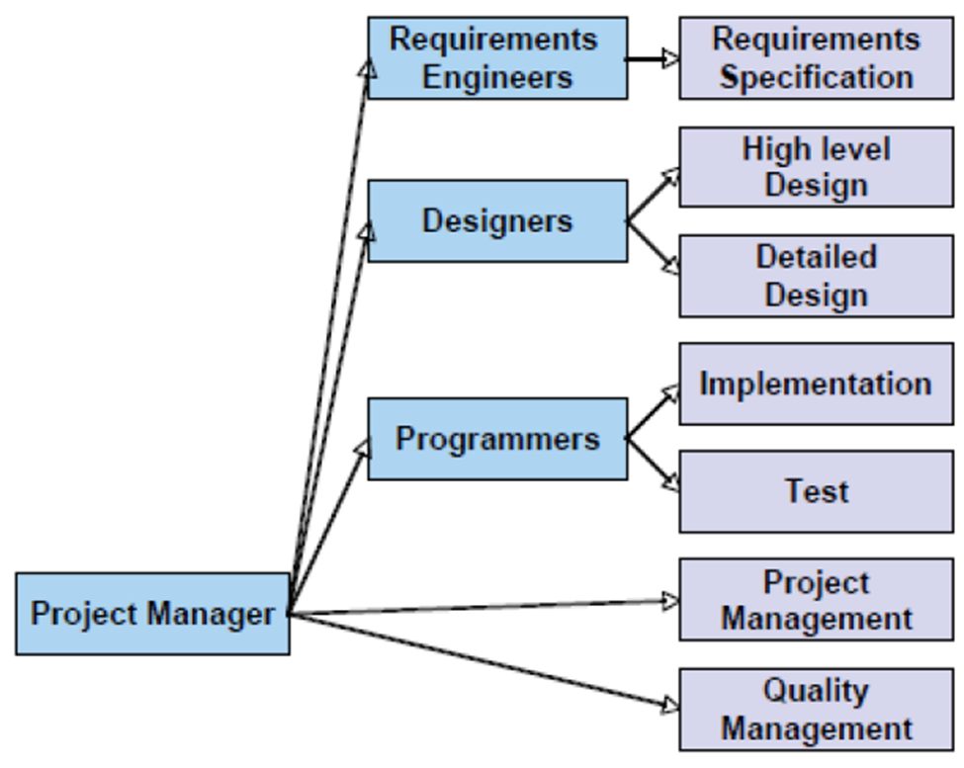
Team Structures
Consider the team structure (15 mins)
Identify key roles appropriate for the Case Study project.
Identify the contributions these roles will bring.
Decide on a structure of the team (e.g. centralized, decentralized, etc).
Controlled Centralised
Controlled Decentralised
Democratic Decentralised
Scrum Team

Slide 6
Today’s aim
Explore teams and the understand the different roles that individuals play in those teams. Communication (including conflict management).

Slide 7
Communication Models
What is your own experience of communication?
Draw your own model
Who
Says What
How
To Whom
Outcome

Slide 8
Conflict resolution
John and Ken share an apartment. For the past week Ken's friend has come over and they have played video games until the early hours of the morning. This effects Ken's sleeping, and he didn't do well on a test one morning.
Using good communication and conflict resolution skills, work though Johnny and Ken's issue and resolution to the problem.
Select what you think is the best italic option and read the answer:
Hey Ken, can we talk about your friend coming over and how it's affecting me? CORRECT
Hey Ken, why does your friend have to stay here all the time?
Johnny grabs Ken by the shoulder and tells him he's tired of this.

Slide 9
Conflict resolution
“Sure, what's up Johnny? You said you
were chill with it before...”
Select what you think is the best italic option and read the answer:
I know we agreed it was ok. But last Thursday I wasn't able to sleep and so didn't do well on my test Friday morning. I'd really appreciate it if we could work something out. CORRECT
Yeah I changed my mind, he stays too often and I don't like it!
Johnny pushes Ken for reminding him that he said he was OK with it before

Slide 10
Conflict resolution
“"Hey Johnny, your test scores are bad because you didn’t study!"
Select what you think is the best italic option and read the answer:
Please don't change the subject, Ken. I don't mind that you friend visits but I would really appreciate some kind of compromise. CORRECT
What?! Who says I am getting bad test scores! I just need a good night's sleep!
Johnny punches Ken for insulting him.

Slide 11
Interpersonal Communication
Exercise- Role play
What if you were the manager?
What if you were a member of the team?
Alex is a brilliant programmer
Alex has been late 3 of the last 10 days
Alex missed a meeting
Alex got the specifications wrong and wasted 2 days of coding time because of a missed meeting
Has been at the company for 3 years and is usually on time
Alex does not eat lunch with the other people in the company

Slide 12
S.M.A.R.T. Feedback
In your groups, discuss an appropriate feedback message.
Hi there Alex,
You’re usually one of the first employees in the meeting room and I’ve noticed recently that there’s been a few occasions where you’ve been late or missed a meeting. If this happens in the future could you please follow up on the meeting minutes just to ensure that you’ve kept up to date regarding project specifications.
Specific
Measurable
Achievable
Relevant
Timely

Slide 13

Interpersonal Communication
Skills
Listening
1. Direct probe
2. Open
3. Closed
4. Objective criteria
5. Testing
6. Softening up
7. Hypothetical
8. Reflective
9. Leading
10. Rhetorical
11. Stupid
12. Trick compliment
13. Back on Track
14. False dilemma
8. acknowledge feeling
9. suggests one answer
4. facts to defuse contention
5. already know the answer
6. build rapport
7. “what if” exploration
What, why and when is an OPEN question appropriate
What, why and when is is a CLOSED question appropriate

Slide 14
Thank You!

